Slide 1
CMSC 23
COURSE DESCRIPTION
Major programming paradigms: imperative, functional, logic, and object-oriented programming
SECTION 1:
Descriptive paradigms, functional and logic
Programming Paradigms
(2 hours of lecture, 3 hours of laboratory)

Slide 2
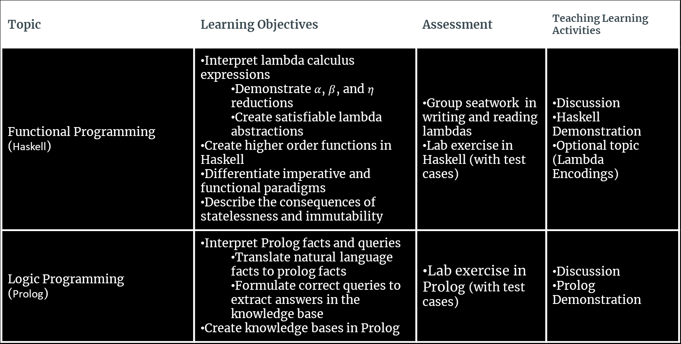
Topic | Learning Objectives | Assessment | Teaching Learning Activities
Functional Programming (Haskell) | Interpret lambda calculus expressions Demonstrate $α$, $β$, and $η$ reductions Create satisfiable lambda abstractions Create higher order functions in Haskell Differentiate imperative and functional paradigms Describe the consequences of statelessness and immutability | Group seatwork in writing and reading lambdas Lab exercise in Haskell (with test cases) | Discussion Haskell Demonstration Optional topic (Lambda Encodings)
Logic Programming (Prolog) | Interpret Prolog facts and queries Translate natural language facts to prolog facts Formulate correct queries to extract answers in the knowledge base Create knowledge bases in Prolog | Lab exercise in Prolog (with test cases) | Discussion Prolog Demonstration

